Slide 1



Sydney harbor bridge
by kaydence

Slide 2
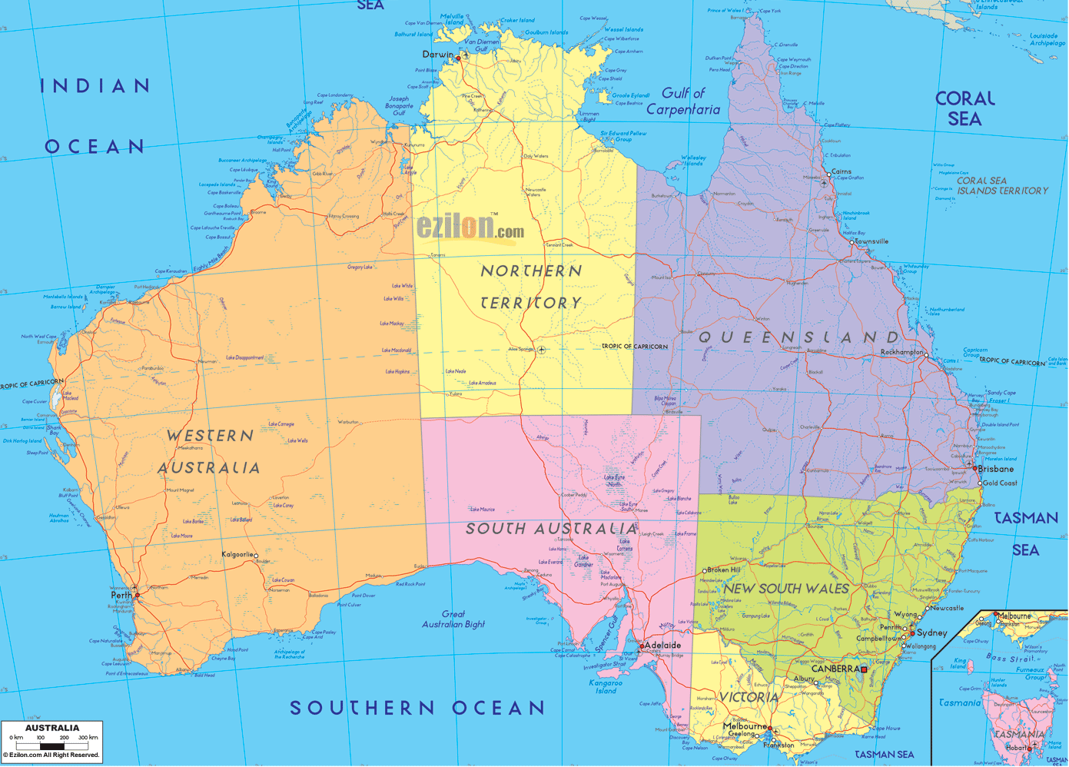

Interesting facts about the Sydney harbor bridge
Kids can climb the Sydney harbor bridge…you must be 8 years old and over 1.2 meters tall
it was built in july 28,1923. its 96 years old.
It was built in australia
It was built with steel, granite, and concrete

Slide 3
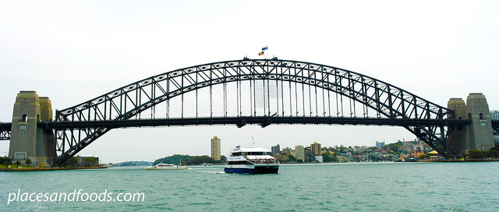
measurments
width is 161 feet
length is 3,770 feet
height is 440 feet

Slide 4
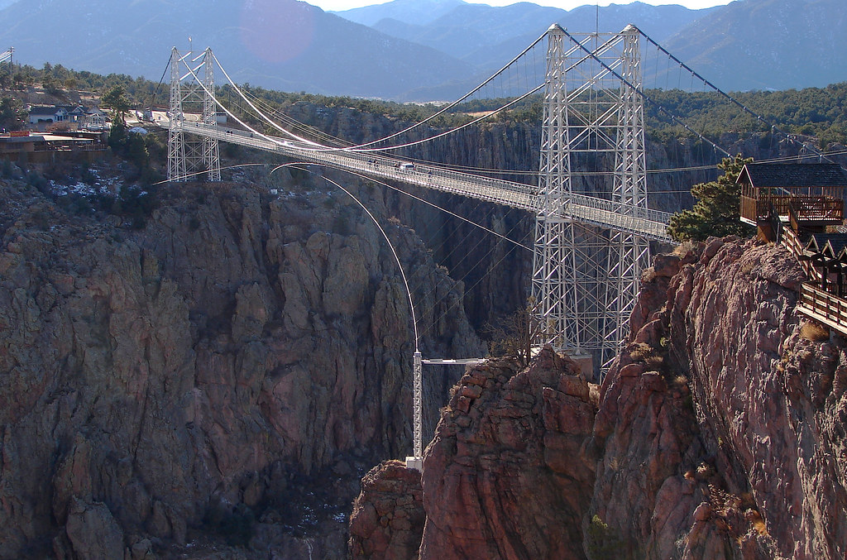
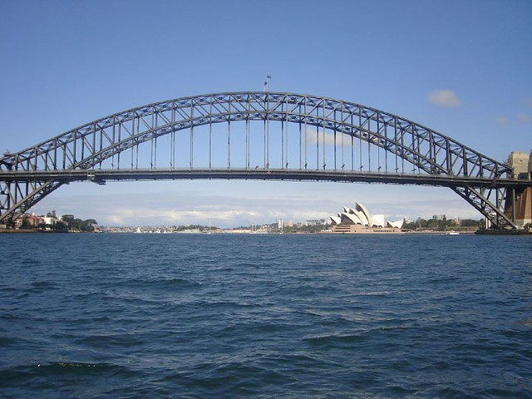
compairing
.the royal Gorge bridge length is 1,260 feet
.The Sydney harbor bridge length is 3,770 feet

Slide 5
Researched and Produced by
Kaydence
3rd grade
Buck Lake Elementary School
Tallahassee,FL

